Slide 1
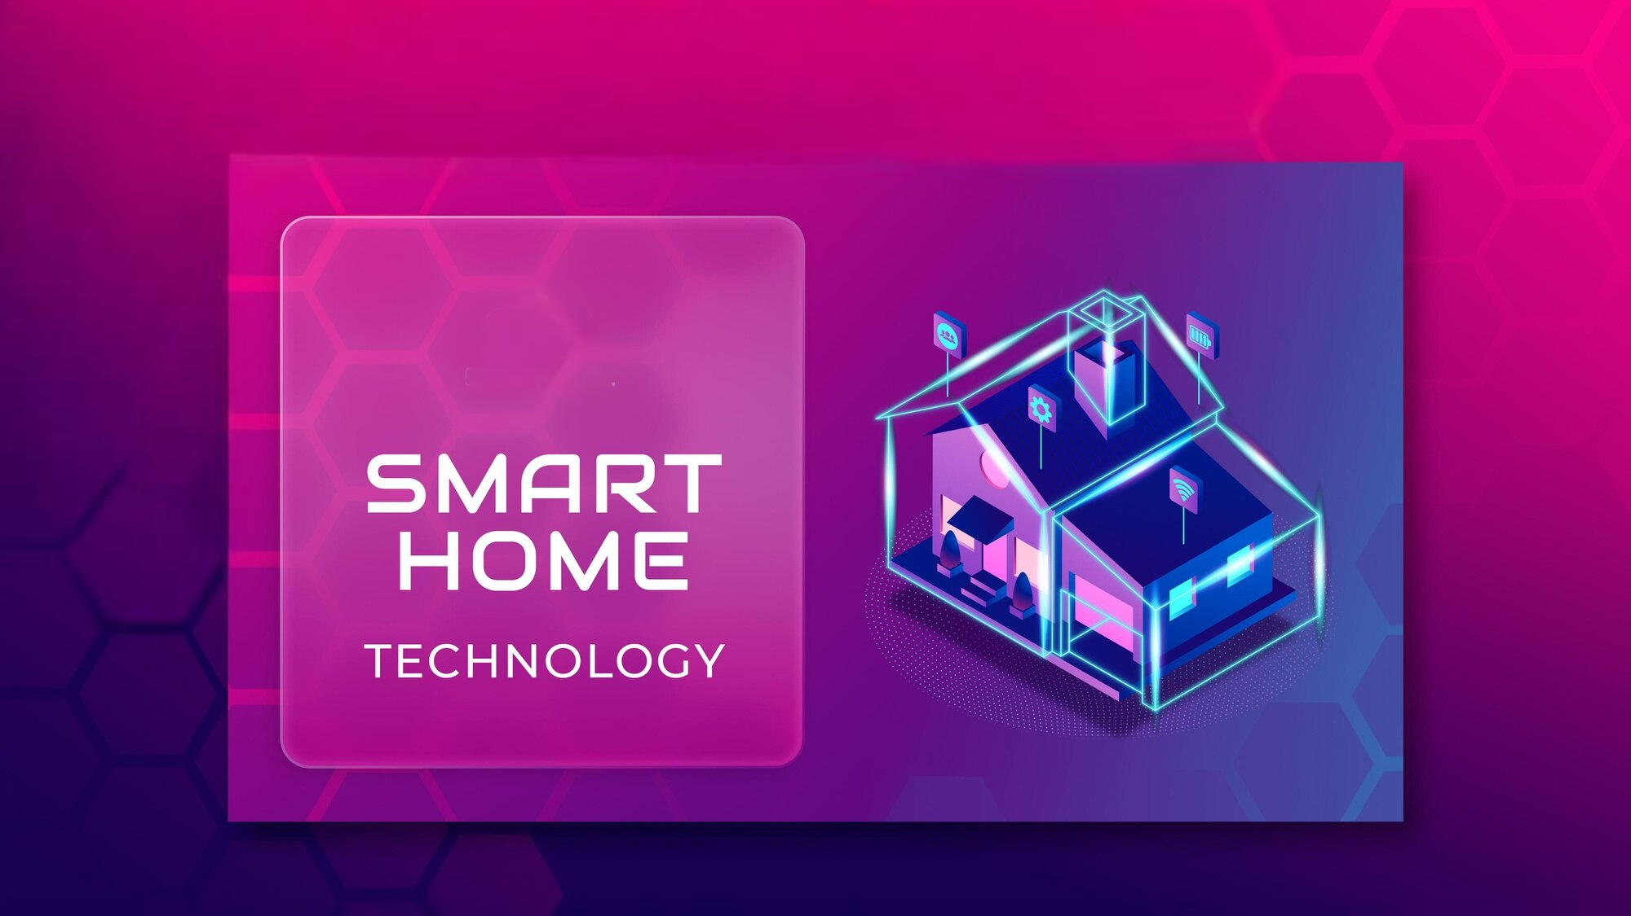
PRESENTED BY :
K. VIKASH
G. SHYAMALA

Slide 2
Introduction to Smart Home Technology
Concept and Significance: Smart home technology refers to the integration of technology into home systems to enhance security, convenience, and environmental monitoring.
Enhanced Security: Automated systems can detect intrusions and alert homeowners, providing peace of mind.
Environmental Monitoring: Continuous monitoring of environmental conditions helps in maintaining a safe and comfortable living space.

Slide 3
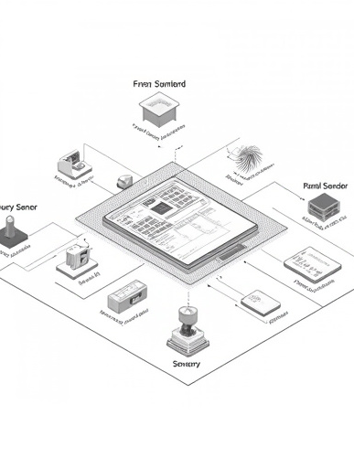
Overview of the Smart Home System
Components and Functionalities: The smart home system is built around the ESP32 microcontroller, which serves as the central unit, coordinating various components.
Key Components:
Sensors: DHT11, flame sensor, MQ2, moisture sensor, and vibration sensor.
Actuators: Relays, water pump, and fan.
User Interface: AsyncWebServer for web-based control.
Functionalities:
Real-time monitoring: Continuous tracking of environmental conditions.
Automated responses: Immediate actions based on sensor data, enhancing safety and efficiency.

Slide 4

Integrating Sensors like DHT11, Flame Sensor, Moisture, and MQ2
Sensor Details: The system incorporates several key sensors to monitor environmental conditions and detect hazards.
DHT11: Measures temperature and humidity, providing essential data for climate control.
Flame Sensor: Detects fire, triggering alarms and safety measures.
MQ2: Monitors gas levels, alerting users to potential gas leaks. Automatically turns off the gas regulator and sends an alert to the homeowner.
Moisture Sensor: The moisture sensor is crucial for garden irrigation, ensuring plants receive adequate water. Functionality: Monitors soil moisture levels and activates the water pump when moisture is low.

Slide 5

Automation in Action: Gas Leak and Low Moisture
Real-World Scenarios: The smart home system demonstrates its capabilities through specific automated responses.
Gas Leak Response: Automatically turns off the gas regulator and sends an alert to the homeowner.
Low Moisture: It automatically turned on the pump in the garden when the moisture is low in the garden.

Slide 6
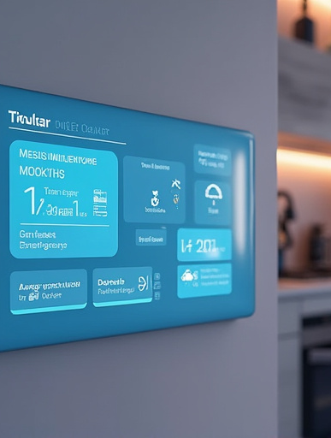
Notifications Alerts
Emergency Alerts: The implementation of this technology allows the system to send notifications in case of emergencies.
Gas Leaks: Immediate alerts when gas levels exceed safe thresholds.
Adverse Weather: Notifications during rain or severe weather conditions.
Fire Detection: It gives immediate alerts when flame is detected in the home to take action.

Slide 7
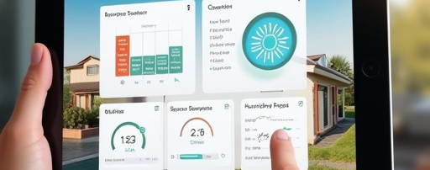

Web Interface or Application
User-Friendly Control
Advantages of AsyncWebServer
The AsyncWebServer provides a web-based interface for users to monitor and control the smart home system. Users can display sensor data with real-time updates on temperature, humidity, and gas levels. Additionally, they can control appliances by turning them on or off remotely.
The system offers several advantages: accessibility allows control from anywhere using a mobile device, while an intuitive design ensures easy navigation and a user-friendly layout that enhances the user experience.

Slide 8

Conclusion: The Future of Smart Homes
Vision for the Future: The future of smart home technology holds immense potential for improving safety and efficiency in everyday life.
Integration of AI: Future systems may incorporate artificial intelligence for smarter decision-making.
Sustainability: Enhanced energy efficiency and resource management will contribute to a greener planet.
Final Thoughts: Smart home automation not only enhances security and convenience but also paves the way for a more sustainable and efficient future in home living.

Slide 9

THANK YOU

